Slide 1
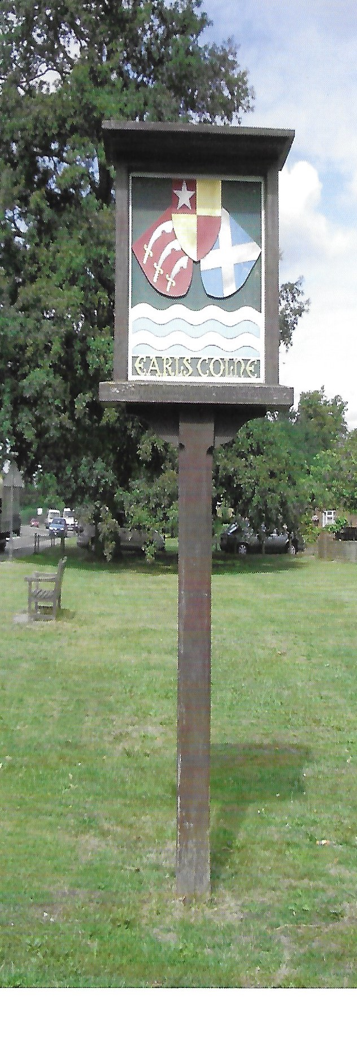
Earls Colne Neighbourhood Plan
Proposed Way Forward
For discussion at the Parish Council Meeting 19th December 2018

Slide 2
Summary of Proposals
Agree to proceed with the Neighbourhood plan based on the outcome of the campaign to engage volunteers
Form a Parish Council Neighbourhood Plan Sub Committee
Form a Neighbourhood Plan Steering Group and arrange an initial meeting in early 2019
Consider potential members of Task Groups with leaders of each group a member of the steering Group (for ease of communication)

Slide 3
Parish Council Neighbourhood Plan Sub Committee
Members:
Tony Calton
Hugh Street
Margaret Barrett
Mort Smith
Possibly consider a further member in light of the current situation with Mort?
Reminder of Main Responsibilities
Qualifying body responsible for the production of the Neighbourhood Plan.
Financial control, and ensuring adherence to statutory requirements
Made up of 3 or 4 members of the Parish Council

Slide 4
Neighbourhood Plan – Steering Group
Potential Members:
Name | Possible Leaders of Task Groups
 | Housing | Environment | Economy | Community Facilities | Infrastructure
Tony Calton
Jayne Meleschko |  | X |  | X
Janet Baldwin | X | X | X | X | X
Sheila Boyce
Robert Cook | X |  |  |  | X
Sharon / Paul Copsey | X | X |  | X | X
Donna Goodchild | X | X
Catherine Hayes | X | X | X | X
Denise Siddall | X | X | X |  | X
Tim / Nicki Spelling |  | X |  |  | X
Reminder of Main Responsibilities
Preparing timelines, budgets and funding proposals.
Co-ordinating evidence gathering and preparation of the draft plan.
Made up of representation from Parish Council plus local residents. (around 8 to 10 people in total)

Slide 5
Neighbourhood Plan Task Groups Potential Members
Colour Coding
One Group
Two Groups
Three Groups
Four Groups
Five Groups
Housing
Janet Baldwin
Marilyn Bryant
Catherine Hayes
Denise Siddall
Carolyn Alston
Robert Cook
Paul Copsey
Sue Gill
Donna Goodchild
Mike
Environment
Janet Baldwin
Marilyn Bryant
Catherine Hayes
Denise Siddall
Carolyn Alston
Gill Carter
Sharon Copsey
Sue Gill
Donna Goodchild
Tony Hill
Jayne Meleschko
Yvonne Rosie
Lorna Shaw
Nicki Spelling
Economy
Janet Baldwin
Marilyn Bryant
Catherine Hayes
Denise Siddall
David Bryant
Malcom Hobbs
Community Facilities
Janet Baldwin
Marilyn Bryant
Catherine Hayes
Denise Siddall
Jeff Carter
Gill Carter
Sharon Copsey
Jayne Meleschko
Nicki Spelling
Infrastructure
Janet Baldwin
Marilyn Bryant
Catherine Hayes
Denise Siddall
Carolyn Alston
Debbie Bremner
Gill Carter
Robert Cook
Paul Copsey
John Munson

Slide 6
Current Situation with volunteers for specific groups
Group | No. Volunteers
Steering Group | 11
Housing Task Group | 10
Environmental Task Group | 16
Economy Task Group | 7
Community Facilities Task Group | 11
Infrastructure Task Group | 13

